Slide 1


Necro Nursery
Team Abra-cadaver

Slide 2
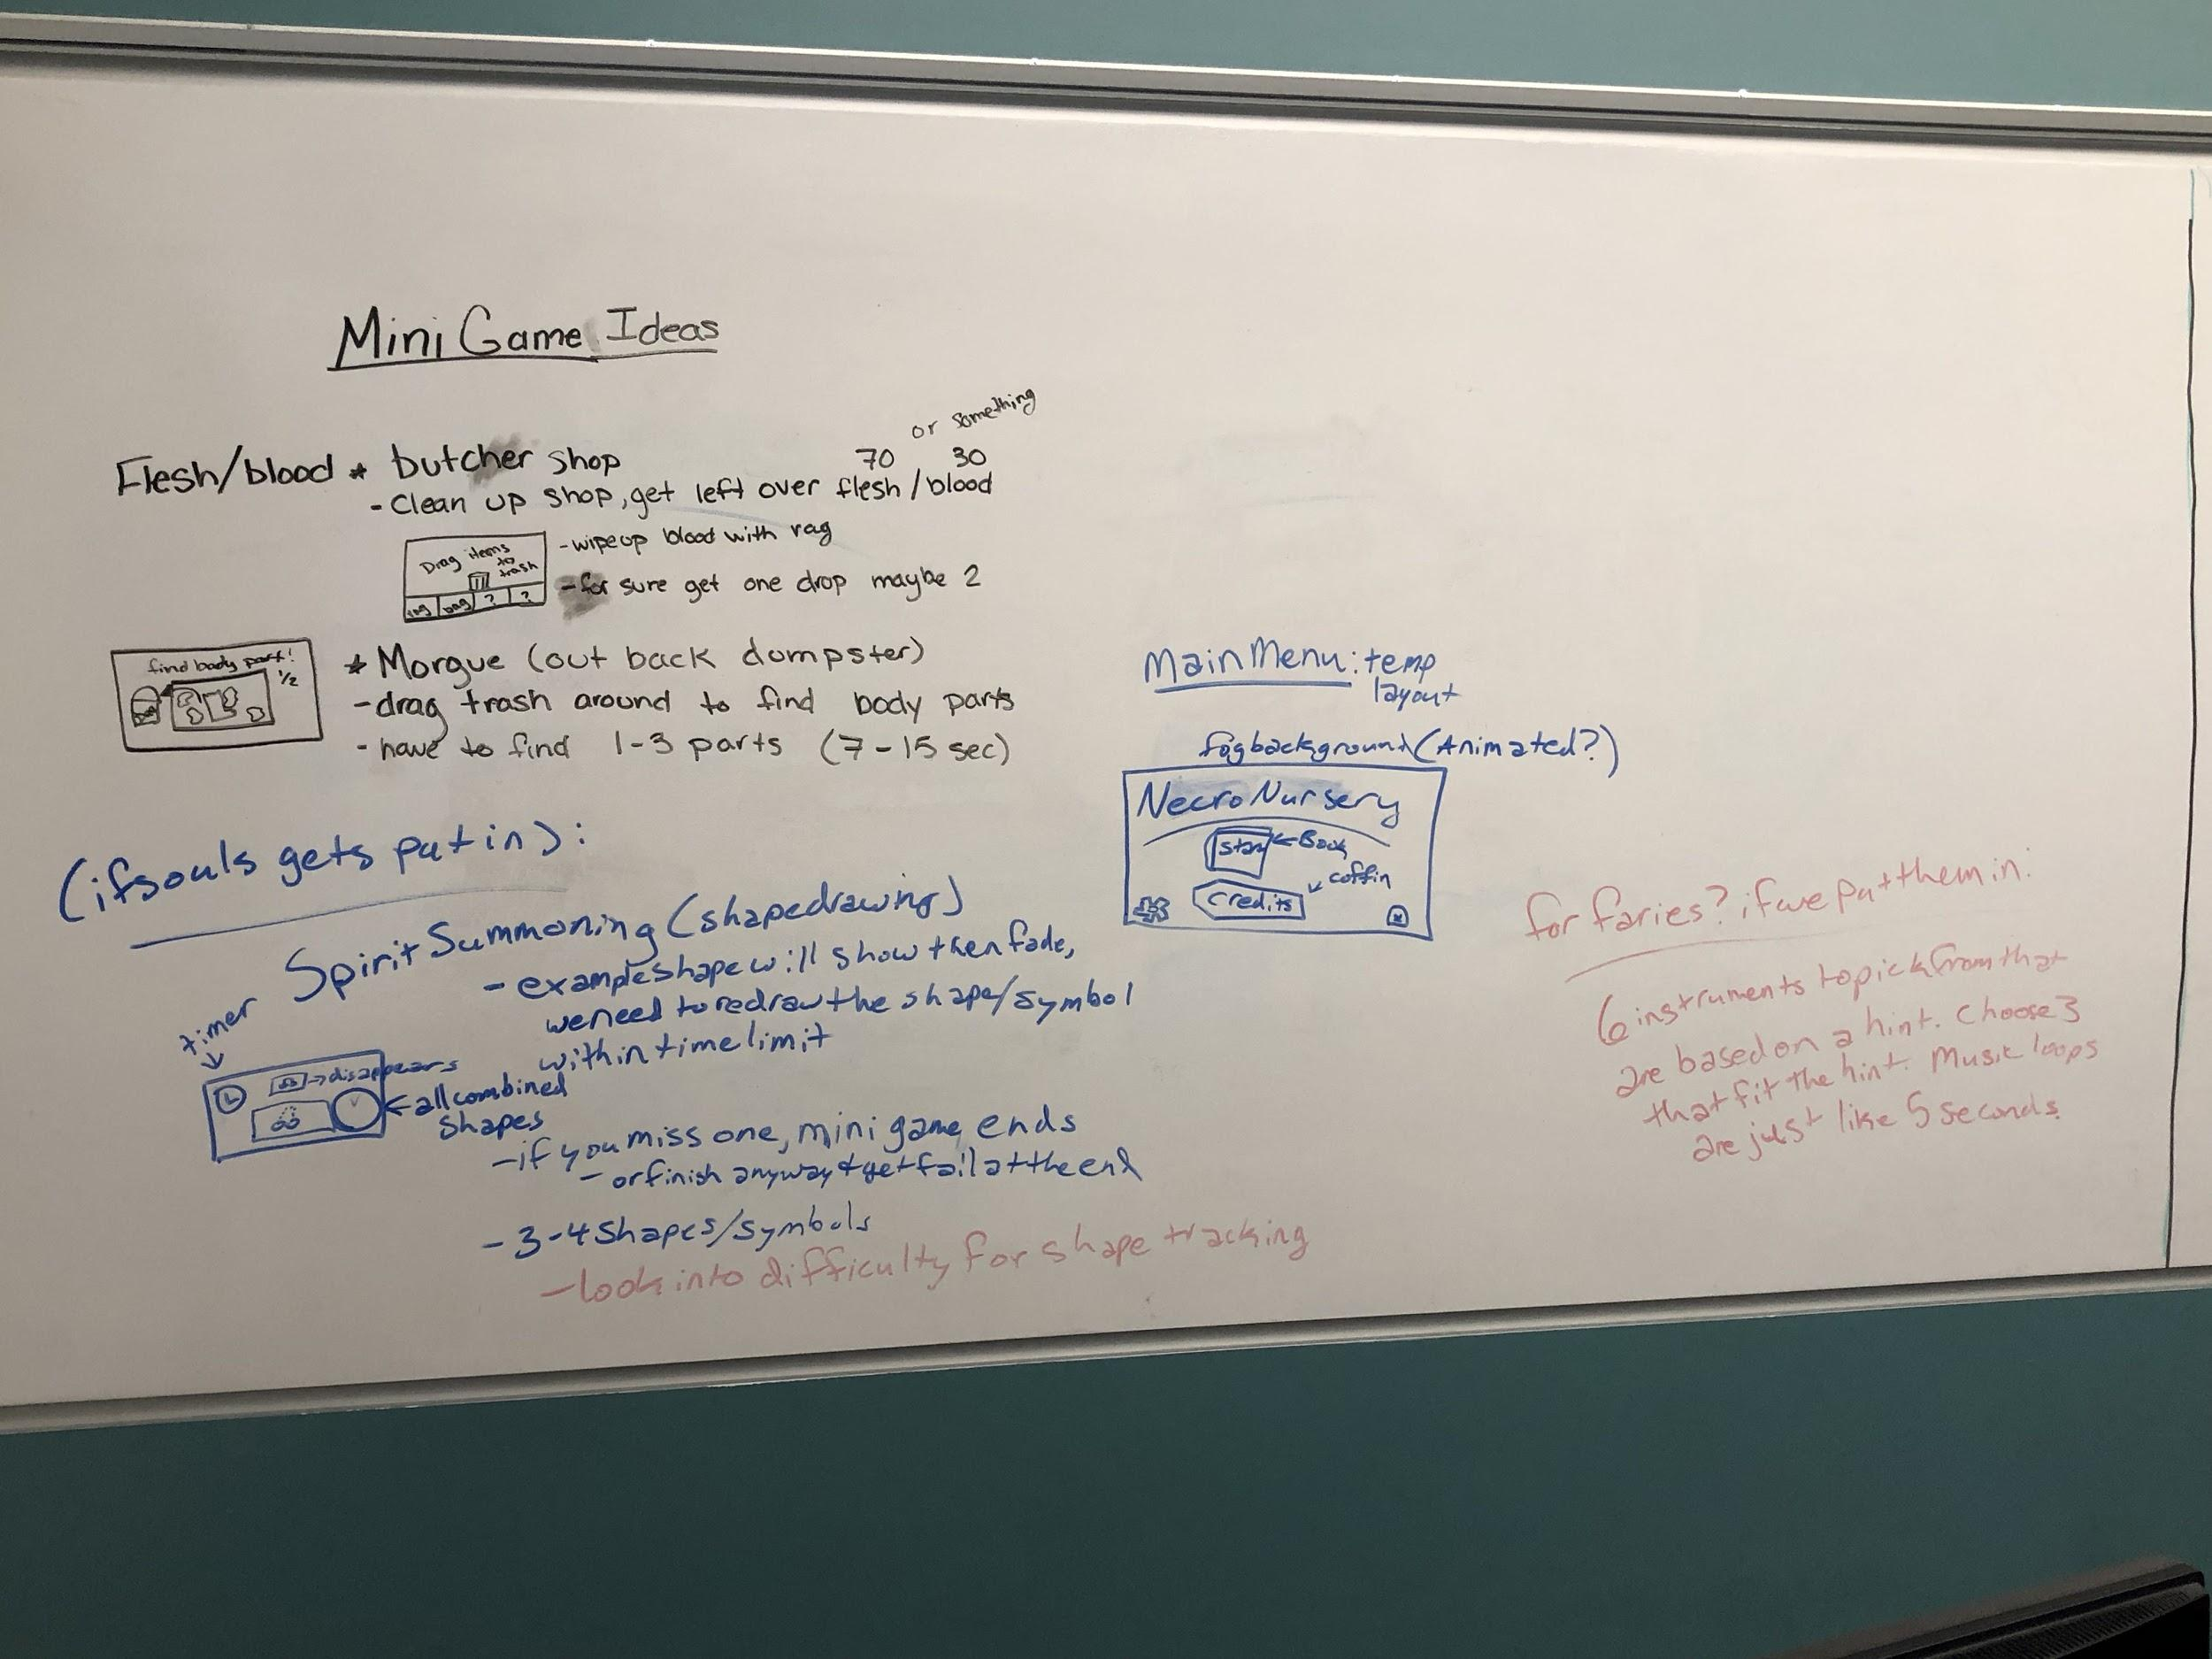
Narrative
Resource Categories
Monster ideas
Brainstormed minigames
Butcher Shop
Morgue

Slide 3

Audio
Created background sound effects
Music soundtracks for all current scenes
Main menu
Graveyard theme
Market theme
Ambience for whatever we need

Slide 4
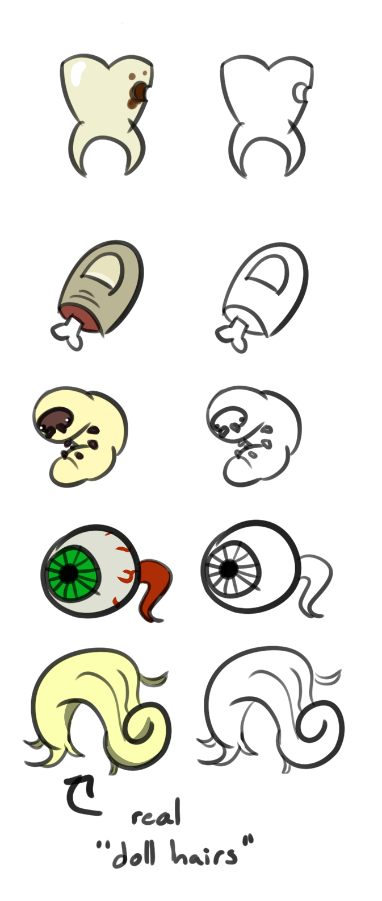
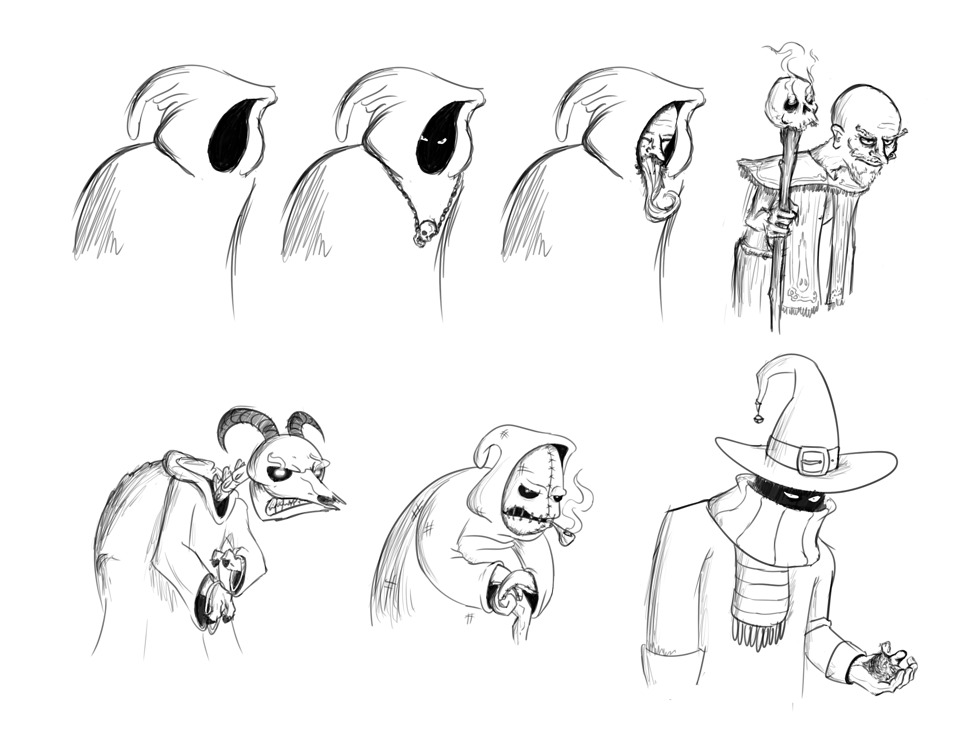
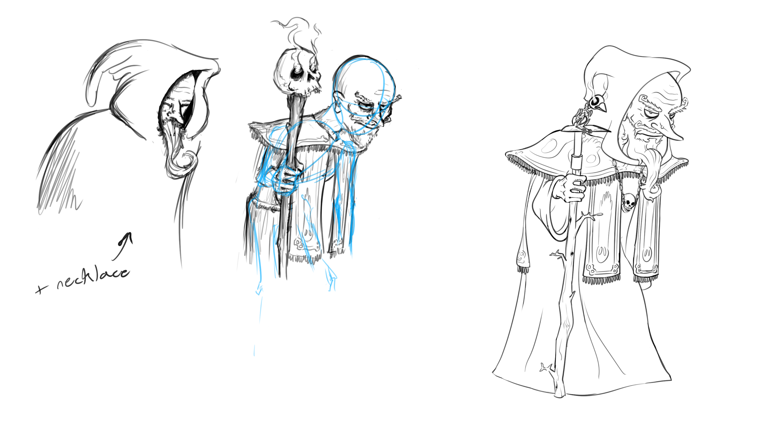
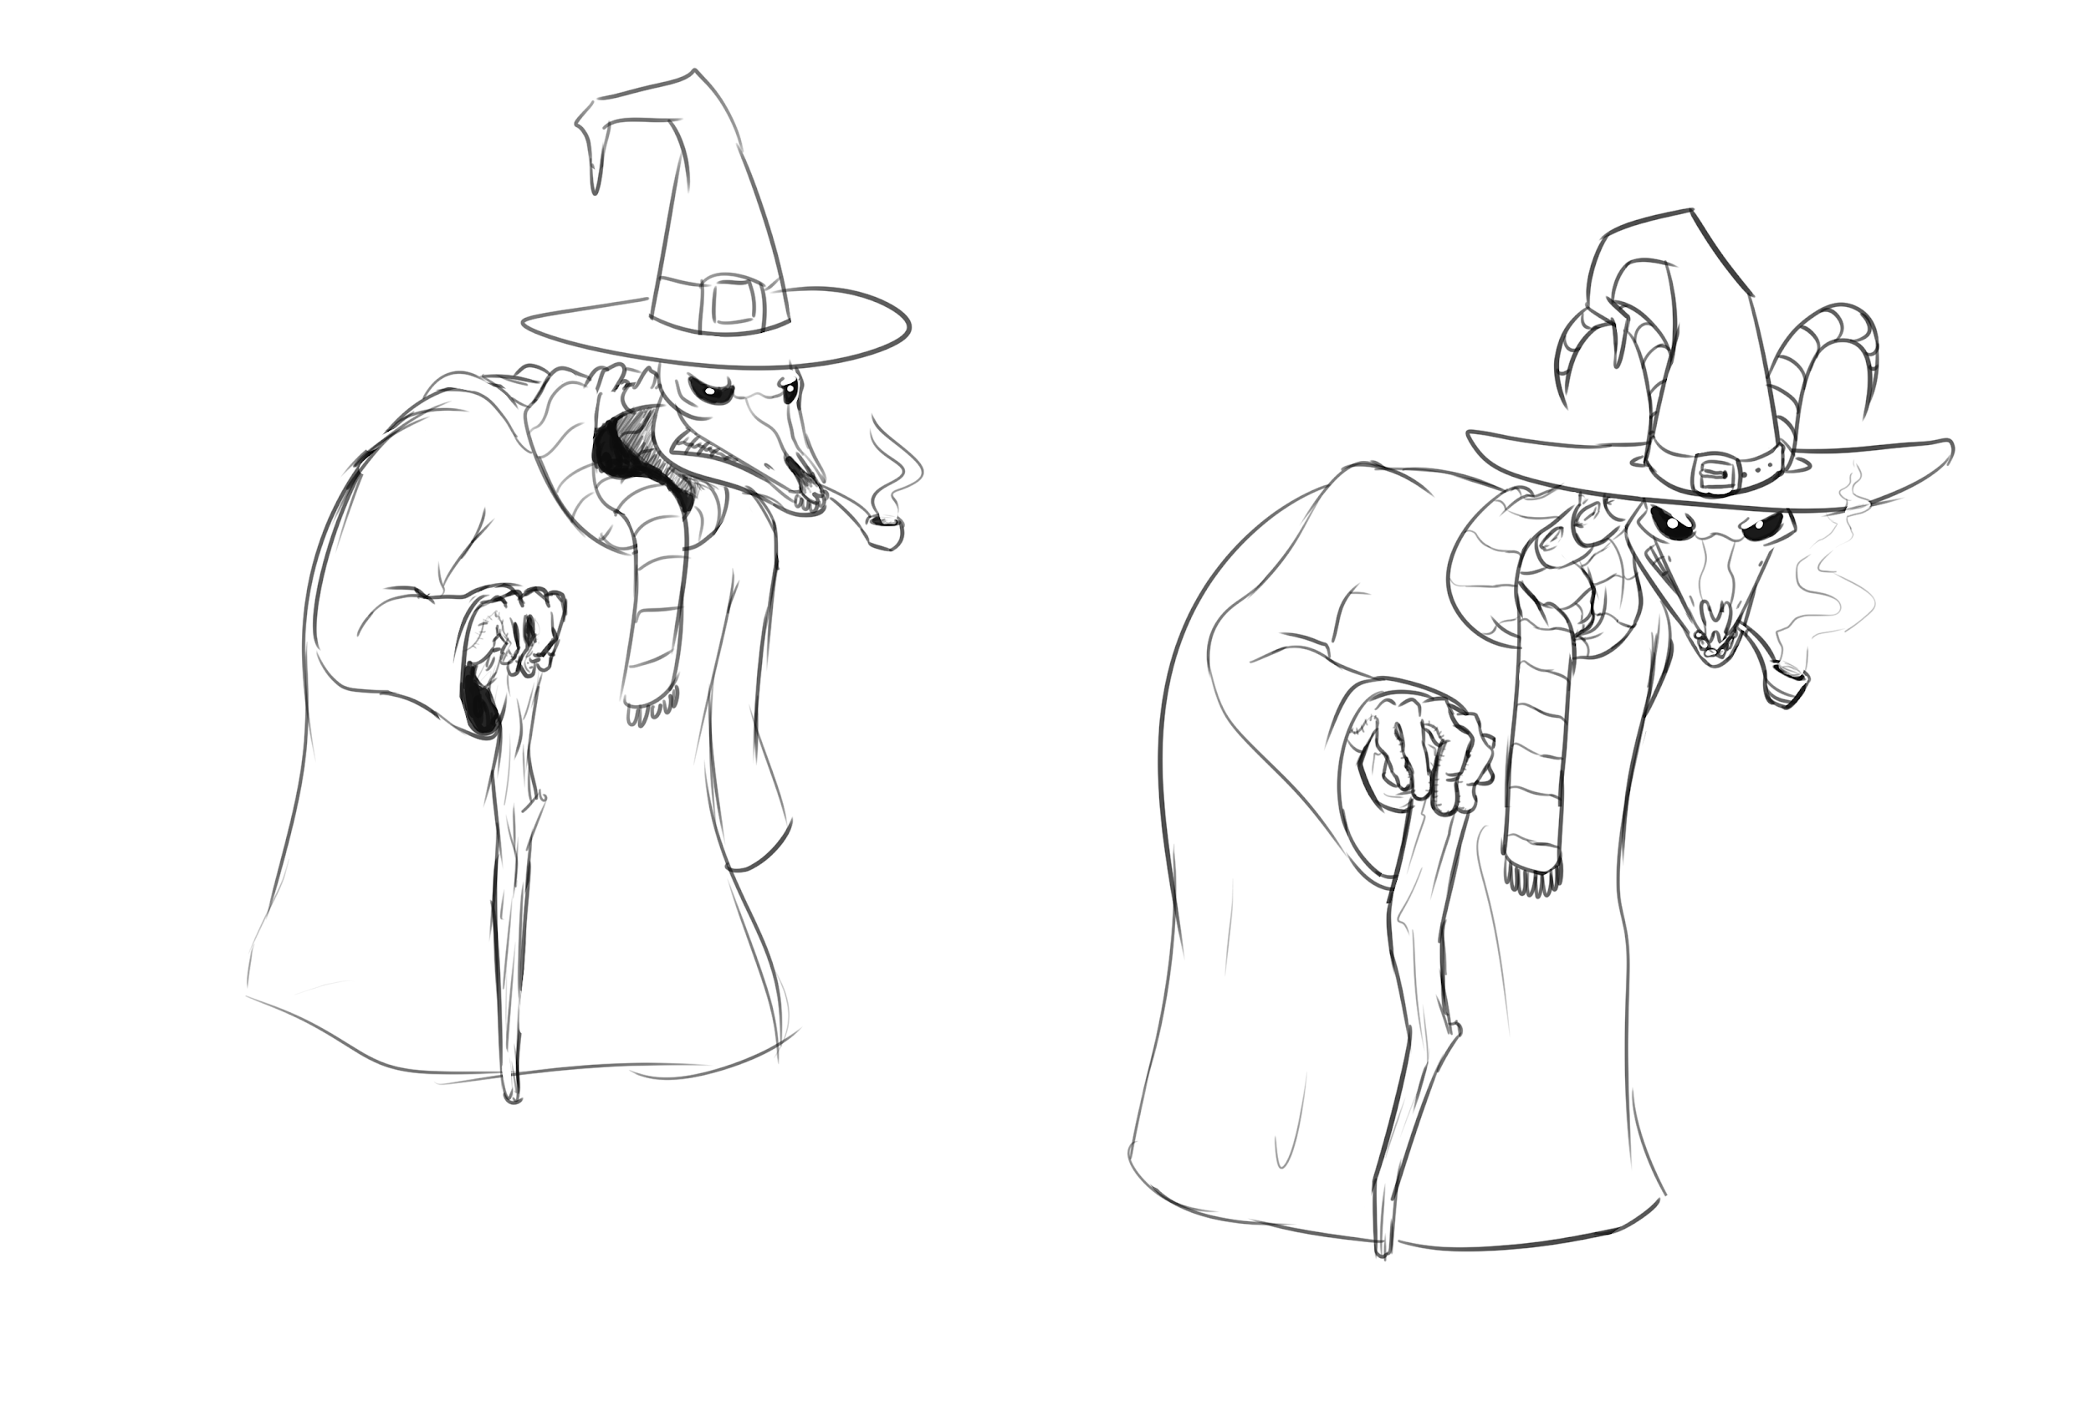

Slide 5
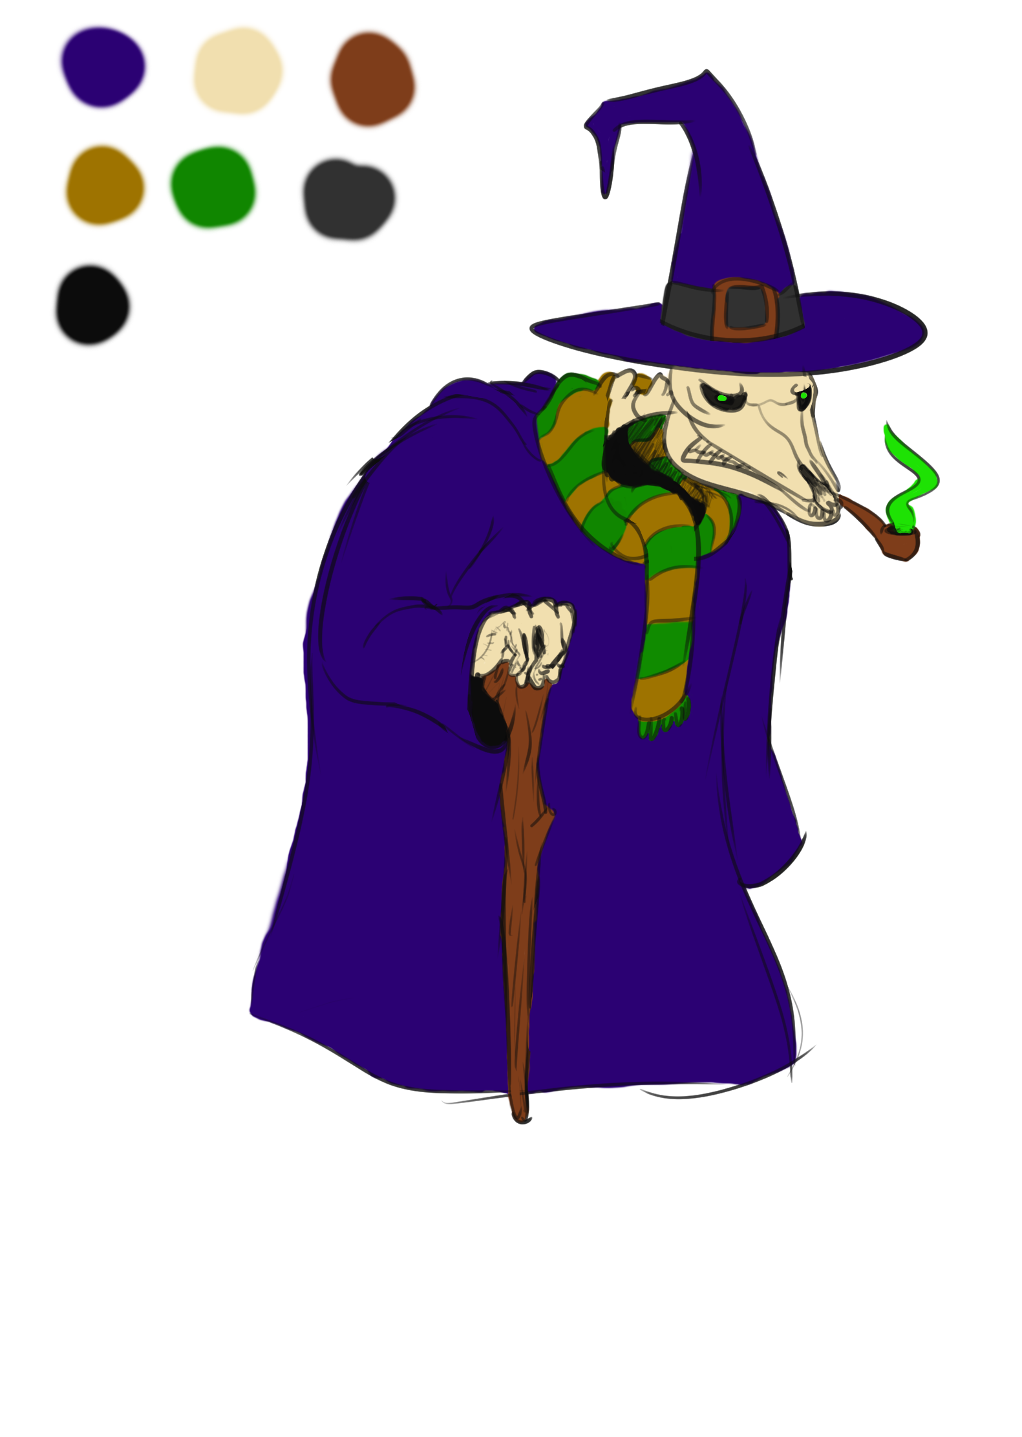
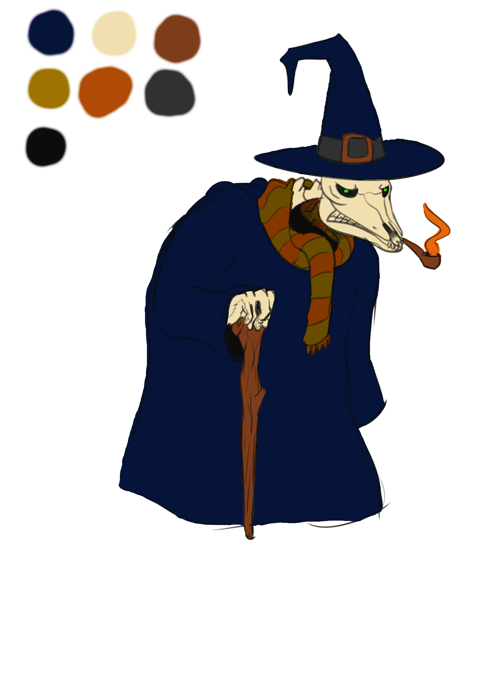
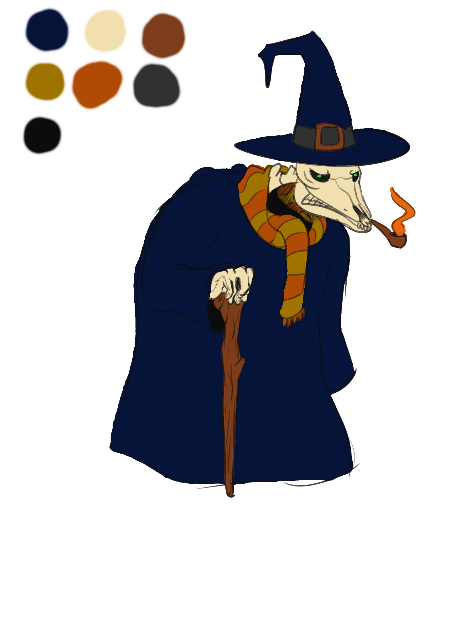
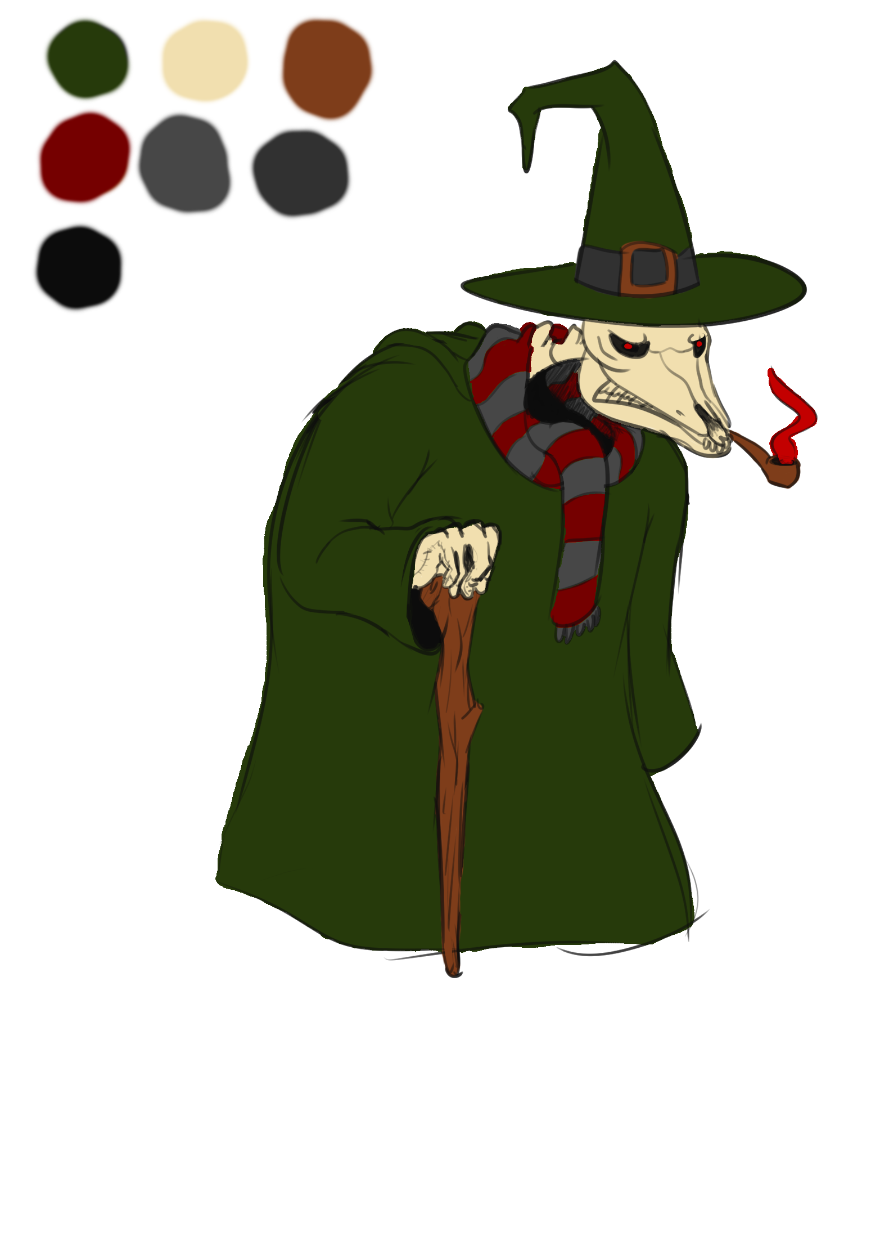

Slide 6
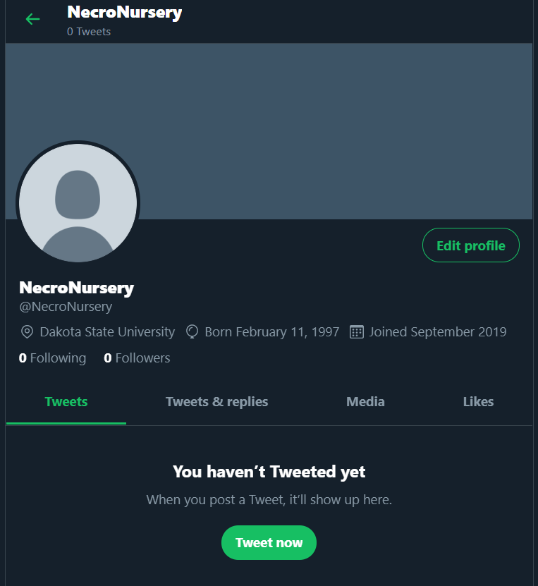
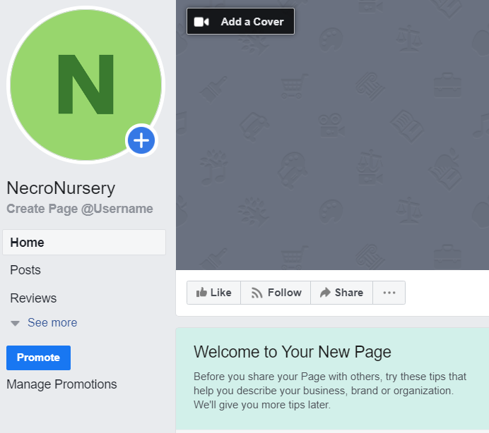
Marketing
Twitter
Facebook
THEY EXIST
THEY’RE LINKED
(I DON’T KNOW WHAT THAT DOES!)
(BUT THERE’S NOTHING IN THEM)

Slide 7
Programming
White boxing
Graveyard
Marketplace
Set up temporary Git server
Swipe to move screen
Tapping a grave shows a blank canvas
Started on
Marketplace logic
Resource management

Slide 8
Troubles along the way?
Implementation of 2.5D based on some of the mechanics we wanted
Programming for phone games on Unity based on experience
ONLY 1 ARTIST (plz help)

Slide 9
What we plan to do!
Begin programming the Morgue minigame
Continue work on Graveyard Scene and Market Scenes
Continue constant playtesting
Begin “full” playtesting once a playable build is created

Slide 10
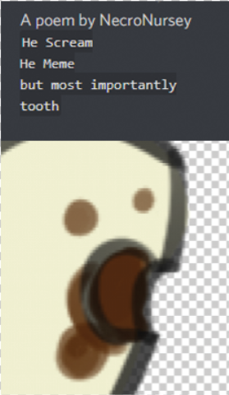
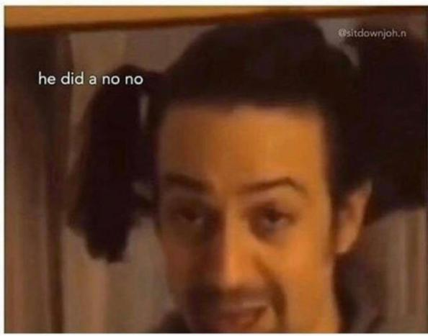
Questions?

